Slide 1
Sales Process Template

Slide 2
Table of Contents
Sales Process Flow Chart
Lead Scoring Process
Lead Nurturing Process
Engaged Prospect Process
Customer Management Process

Slide 3
Process Flow Chart
Lead Discovered
Lead Scoring
Lead Scoring
Discard Lead
Lead Nurturing
Engaged Prospect Process
Customer Management Process

Slide 4
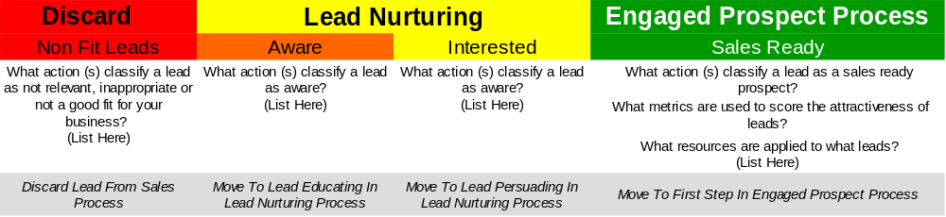
Lead Scoring Process
Lead Discovered
Lead Scoring
Lead Scoring

Slide 5
Lead Nurturing Process
Lead Nurturing Process
Initial Contact | Follow up | Lead Educating | Lead Persuading | Sales Ready
What are all the steps and actions you take (in order) when a prospect contacts you? What questions do you ask? What information do you write down? What benefits or points of difference versus your competition do you discuss? What offers, promotions or free items do you offer? | How long do you wait to follow up? Do you use phone, email or text to follow up? Who makes the follow up? What time of day is the follow up made ? What do you discuss? What benefits or points of difference do you make sure you stress? What sales tactics do you use? Do you offer them anything special? | What do you do to educate leads that still do not fully understand what you offer? | What do you do to persuade prospects that know and understand what you offer but are not convinced of the value of your product or service? | What do you do once a prospect has taken an action to indicate that they believe your product or service is of value and are ready to buy? How is a further meeting or purchase order requested?

Slide 6
Engaged Prospect Process
Engaged Prospect Process
Meeting Preparation | Initial Meeting | Meeting Follow Up | 2nd Meeting Preparation | 2nd Meeting | Sale Fulfilment | Bill Collection
What actions are taken to prepare for the first meeting? | How long between request for meeting and first meeting? What is the ideal location for the meeting? What are the agenda items? What key points are focused on in the 1st meeting? What and points of difference are stressed in the meeting? | When do you follow up? How do you follow up? What information do you stress in your follow up? | What actions are taken to prepare for the 2nd meeting? | How long between 1st and 2nd meeting? What content is agenda and topics covered in the 2nd meeting? What key points are focused on in 2nd meeting? What benefits and points of difference are stressed? | What actions are taken once a customer commits to buying? What paper work needs to be completed to sign on a new customer? What is done to ask for a referral after a sale (this is the best time to ask for a referral)? | When will you send bills? How will you send bills? How will you collect payment? What payment options will you offer? When and how will you contact customers with outstanding balances?

Slide 7
Customer Management Process
Customer Management Process
Follow Up | Customer Communication | Customer Retention | Cross Sell | Up Sell
Post sale, when will you follow up? What questions will you ask? What time of day will you follow up? How will you contact them (phone, email, text, in person etc)? | What news, updates or information will you send your customers? How will you send the information? When will you send the information? What product or service performance information will you share with them? What actions will you take to get referrals from your customers? | What activities will you perform to ensure you maintain your existing customer base? | What activities and actions will you take to attempt to get your customers to buy other non related products and services you sell? | What activities will you undertake to attempt to up-sell your customers other products and services to compliment what they have already purchased?

